Slide 1






ARTIFICIAL INTELLIGENCE
Logistic Regression
Presented by: Nada Hanafi Ahmed
Computer & Communication Department
Alexandria University

Slide 2


Artificial intelligence (AI)
refers to the development of computer systems that can perform tasks that require human intelligence to complete.
These tasks may include reasoning, problem-solving, learning, perception, decision-making and more.
AI’s applications are from voice assistants like Siri and Alexa to self-driving cars and medical diagnosis systems.

Slide 3

Types of AI
Reactive Machines
Limited Memory
Theory of Mind
Self-Aware AI
Algorithms that are programmed to perform a specific task, respond to only current situations.
Applications: chess, automatic doors, chatbots, elevators.
Algorithms that consider past experiences & improve them over time but they are limited in the amount of data.
Applications: image recognition, fraud detection systems.
Algorithms that understand social skills such as people's emotions, intentions and behaviors.
Applications: social robots and educational software.
Algorithms that develop their own beliefs and desires based on past experiences and the emotional and mental state of others.
No applications has been done yet.
LEVEL
UP

Slide 4




Subsets of AI
Artificial Intelligence
Its goal is to create intelligent machines that emulate
and exceed human cognition such as being able to imitate
reasoning and continuously learn from new data.
Machine Learning
Involves training algorithms through data and
learning through these data so that they can solve problems.
Deep Learning
Uses neural networks with multiple hidden layers to
extract additional insights from the input data and deliver more
accurate predictions.

Slide 5
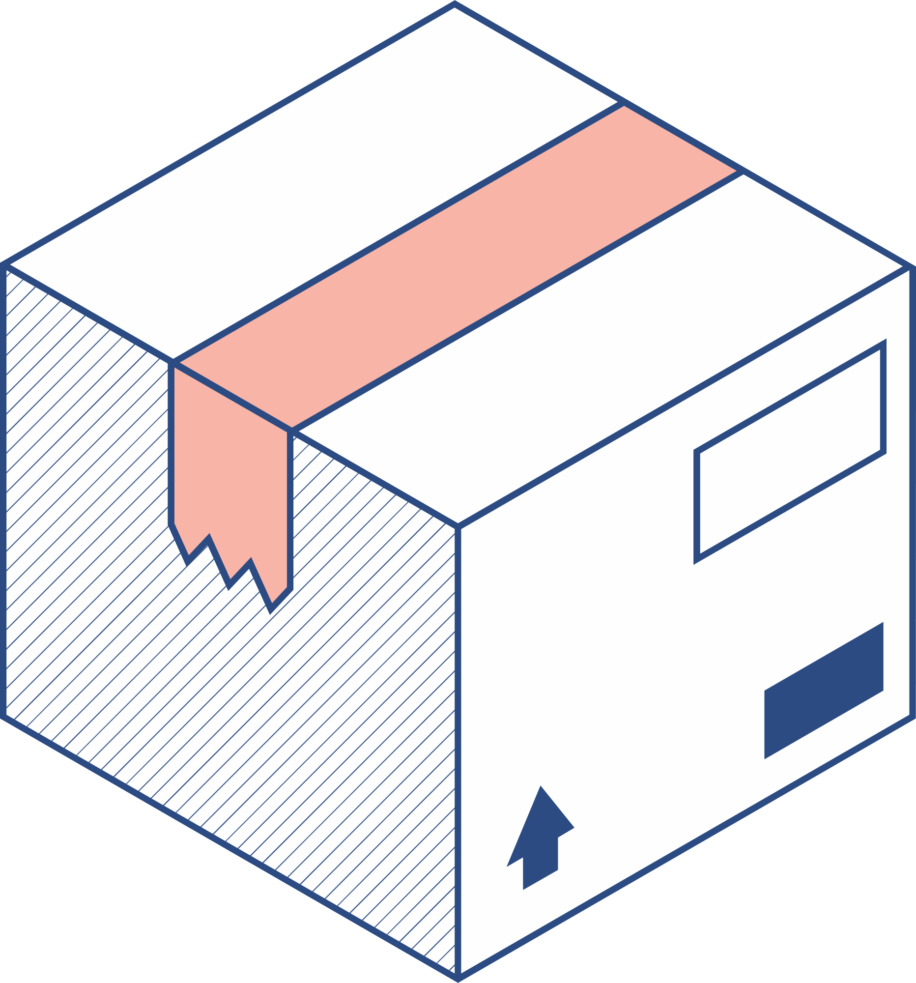



Machine Learning
It is about creating computer programs that can automatically learn from experience and adapt to new situations.
It’s done by feeding large amounts of data to algorithms that can identify patterns and relationships within the data, and use that knowledge to make predictions or decisions in new situations.
Machine learning has a wide range of applications, from image and speech recognition to fraud detection and autonomous vehicles

Slide 6

Types of ML
Supervised Learning | Unsupervised Learning | Reinforcement Learning
Involves training a model on labeled data, labeled dataset is one that has both input and output parameters and using that model to make predictions or classifications on new data. | Involves training a model on neither classified nor labeled data, and having the model find patterns and relationships within the data on its own | Involves training a model through trial and error, where the model receives feedback in the form of rewards or punishments for its actions.

Slide 7

How to create ML model
1
2
3
4
5
6
7
STEP
STEP
STEP
STEP
STEP
STEP
STEP
Data collection
Data preparation
Model selection
Model training
Model evaluation
Parameter tuning
Predictions

Slide 8
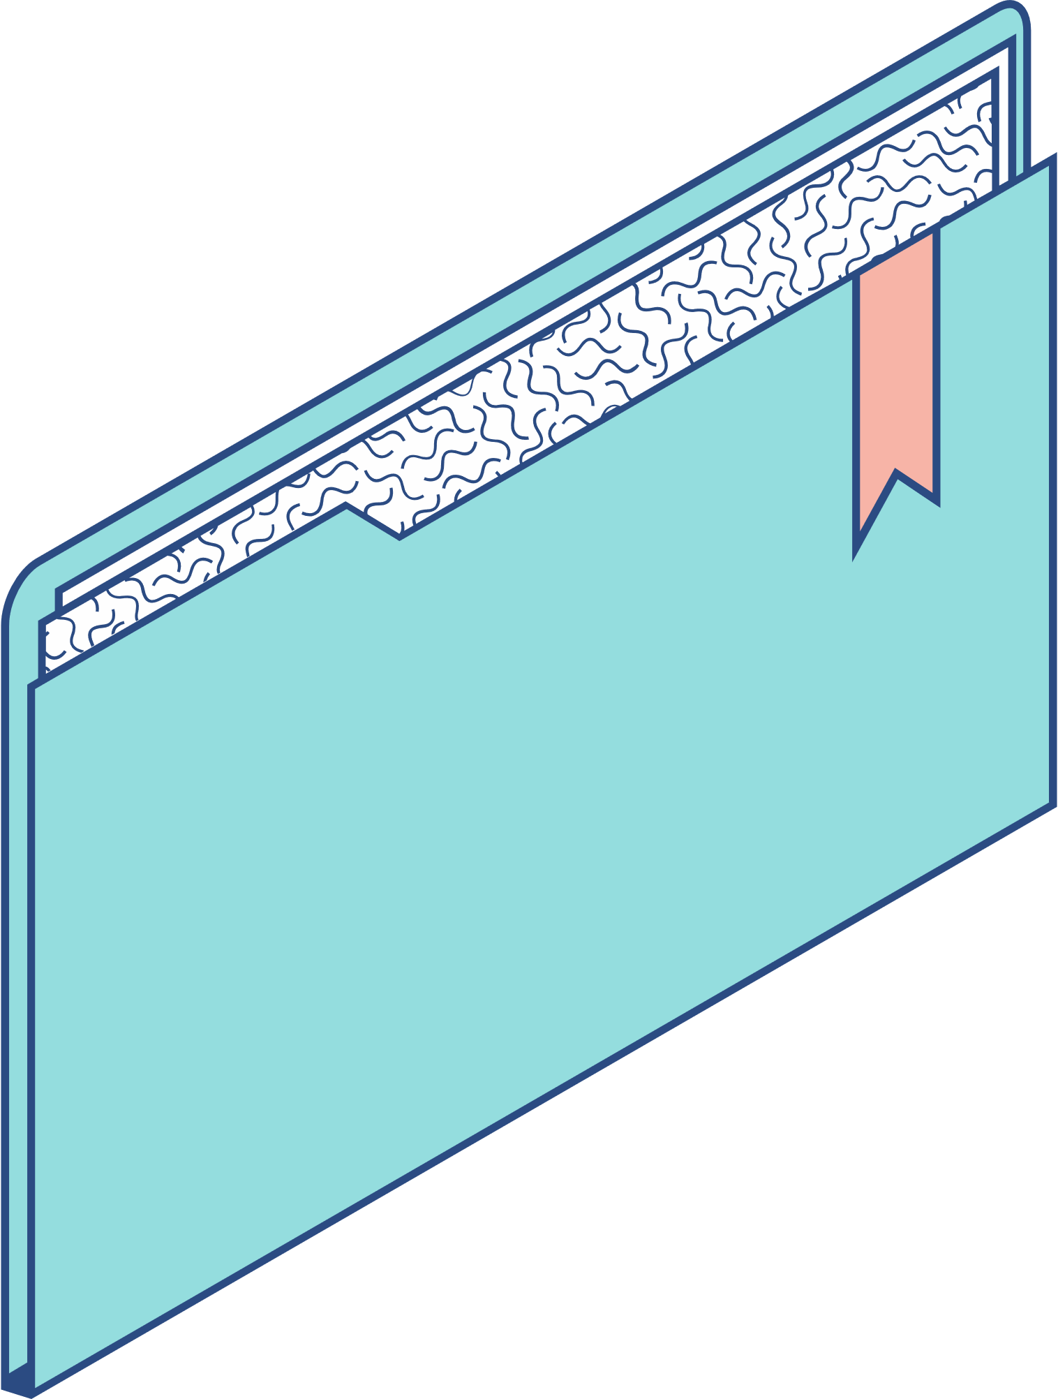


Linear Regression
IT'S A STATISTICAL METHOD USED TO MODEL THE RELATIONSHIP BETWEEN A DEPENDENT VARIABLE AND ONE OR MORE INDEPENDENT VARIABLES.
it's often used for predicting numerical values such as predicting a person’s height based on their weight and age. It can also be used for understanding the relationship between variables such as the relationship between temperature and air pollution levels.

Slide 9

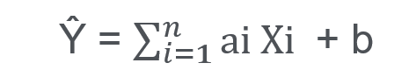
The Equation of Linear Regression Can Be Written as:
the equation provides a straight line that represents the relationship between the dependent and independent variables where Y is the dependent or target and X is the independent variable. The slope of the line indicates how much the dependent variable changes for a unit change on the independent variable/s. in regression we must find the value of Y, so a function is required that predicts continuous Y in the case of regression given X as independent features.
Where i indicate the number of features, a is the coefficient (slope) which represents the change in the dependent variable for a one-unit change in the corresponding independent variable, and b is the intercept which represents the value of the dependent variable, in other words, when all independent variables are equal to zero, it’s the value of the dependent variable that the regression line crosses by then.

Slide 10



Logistic Regression
Logistic regression is a statistical method used to model the probability of a binary outcome (classification tasks) such as whether a customer will purchase a product or not, based on one or more independent variables.
It’s used for predicting the categorical dependent variable using a given set of independent variables. Therefore, the output must be a categorical or discrete value. It can be either yes or no, 0 or 1. It gives the probabilistic values which lie in between 0 and 1 instead of fitting a regression line, we fit an S-shaped logistic function which predicts two maximum values (0 or 1).
Logistic regression is a significant machine learning algorithm because it has the ability to classify new data using continuous and discrete datasets

Slide 11

The difference between linear regression and logistic regression is that
linear regression output is the continuous value that can be anything such as numerical values while logistic regression predicts the probability that an instance belongs to a given class or not.

Slide 12
Types of
Logistic Reggression
I
II
III
Binomial
Multinomial
Ordinal
there can be only two possible types of the dependent variables, such as 0 or 1, pass or fail, yes or no, etc.
there can be 3 or more possible unordered types of the dependent variables, such as cat, dog or bird.
there can be 3 or more possible ordered types of the dependent variables, such as low, medium or high.

Slide 13

Sigmoid Function
The sigmoid function is a mathematical function used in logistic regression to map the predicted values to probabilities of a binary outcome. It’s also known as the logistic function. It maps any real value into another value within a range of 0 and 1, which can’t go beyond this limit so it forms a curve like the “S” form.
The concept of the threshold value which defines the probability is used so that values above the threshold value tends to 1, and values below the threshold value tends to 0.

Slide 14





How it works
The logistic regression model transforms the linear regression function continuous value output into categorical value output using a sigmoid function, which maps any real- valued set of independent variables input into a value between 0 and 1.

Slide 15


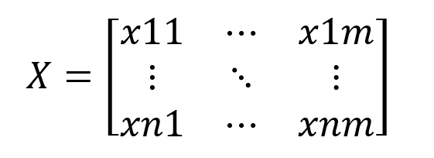
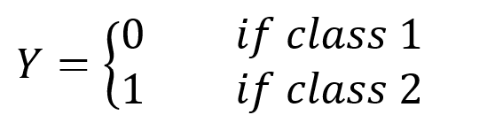
Formulation
Let the independent input featured be the matrix X, where:
And the dependent variable is Y having only binary value either 0 or 1:

Slide 16

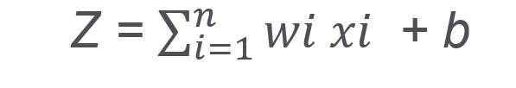
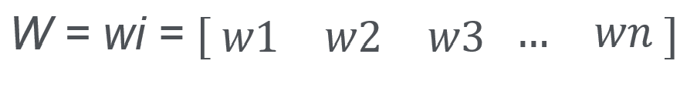


Then apply the multi-linear function (linear regression) to the input variables X:
Where W is the weights of coefficient matrix, and b is the bias or intercept term.
It can be simply represented as the dot product of weight and bias.

Slide 17

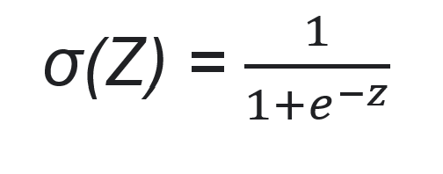
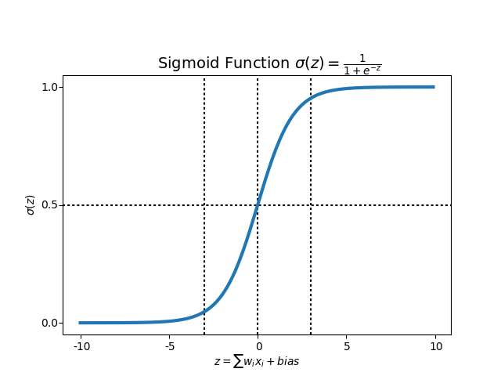
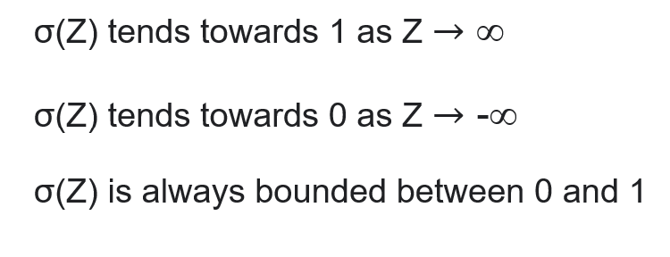

Now we use the sigmoid function where the input will be Z and we find the probability between 0 and 1, predicted Y

Slide 18


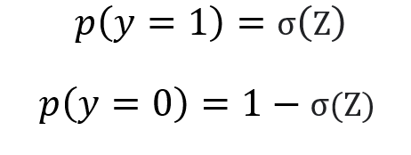
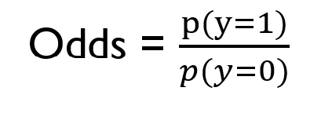
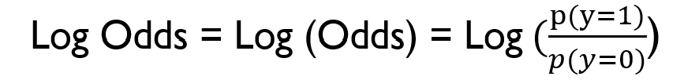

where the probability of being a class can be measured as
Odds
are defined as the probability of the positive outcome divided by the probability of the negative outcome
Log-Odds
known as the logit function, it’s the natural logarithm of the odds

Slide 19
Steps to create logistic regression model
Import required libraries.
1
2
3
4
5
6
7
8
9
10
11
Load dataset.
Prepare dataset.
Deal with outliers.
Get X (Features) & Y (Label) data.
Split data into training and testing sets.
Scale data.
Fit a logistic regression.
Make a prediction.
Evaluate using confusion matrix.
Classification report: Calculate accuracy, F1 and precision scores.

Slide 20

Thank you.

